Slide 1

SOFTWARE ENGINEERING CHALLENGES IN THE MEDICAL DEVICE INDUSTRY Eduardo Barbosa | Inês Lopes – Fraunhofer Portugal AICOS
✓ ________
✗ ________

Slide 2
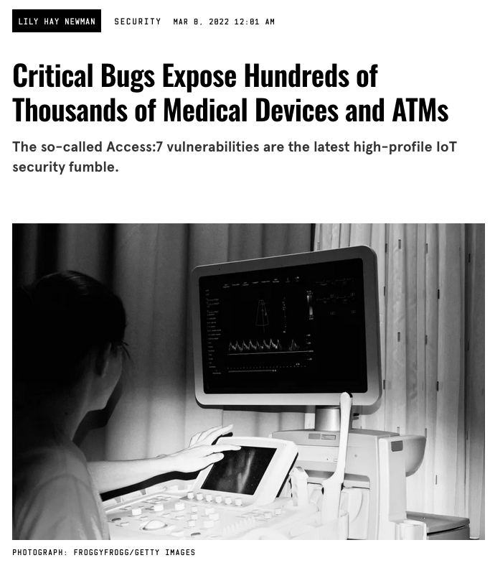
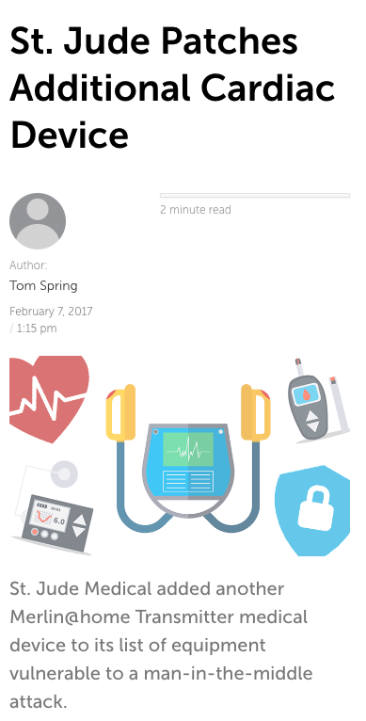

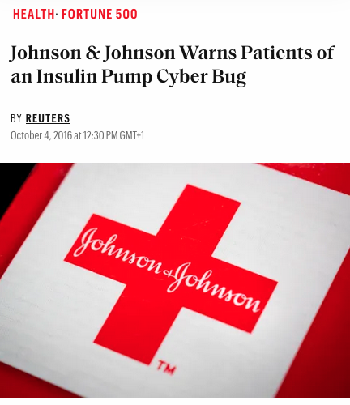
Medical device software is not immune to failure
Protecting the patient’s health, security and their personal data is critical
https://www.wired.com/story/access7-iot-vulnerabilities-medical-devices-atms/
https://threatpost.com/st-jude-patches-additional-cardiac-device/123596/
https://www.washingtonpost.com/news/the-switch/wp/2013/10/21/yes-terrorists-could-have-hacked-dick-cheneys-heart/
https://fortune.com/2016/10/04/johnson-johnson-insulin-pump-cyber-bug/
Notes:
Something you might not have thought of before is that software may also be a medical device.
A medical device can contain software as part of a system – for instance, a blood pressure monitor needs software to run, but it is just part of a wider system which contains a hardware device.
But a piece of software can be a medical device in and of itself. An app that you download on your phone that tracks depression or anxiety symptoms runs regardless of the phone model you’re using. The phone is not part of the medical device – only the app is.
And like every other kind of software, medical device software is not immune to failure. Software _will_ have bugs, and that’s a part of life.
These are some instances when medical device software failures got to the news. Notably, cybersecurity failures usually have more visibility:
In the first instance, a vulnerability found in a remote IoT access tool, used in many medical devices, allowed an attacker to extract sensitive data from medical equipment, tamper with lab results, make devices unavailable, or even take them over entirely.
In the second piece of news, St. Jude Medical, now part of Abbott, discovered and patched a vulnerability In their pacemakers and defibrillators which allowed a skilled remote attacker to access or influence communications between the devices and a back-end server containing patient data.
Even former VP of the US Dick Cheney had the wireless functionality of his heart implant disabled – as this could be used as a surface for an attack, a possible assassination attempt.
In the fourth piece of news, Johnson & Johnson discovered and patched a bug in their insulin pumps which could cause patients to suffer an insulin overdose.
So, as you can see, even big companies can sometimes fail. But the way to overcome this is to minimize the risk by having controls in place – this means adhering to the appropriate regulations and following applicable standards.

Slide 3
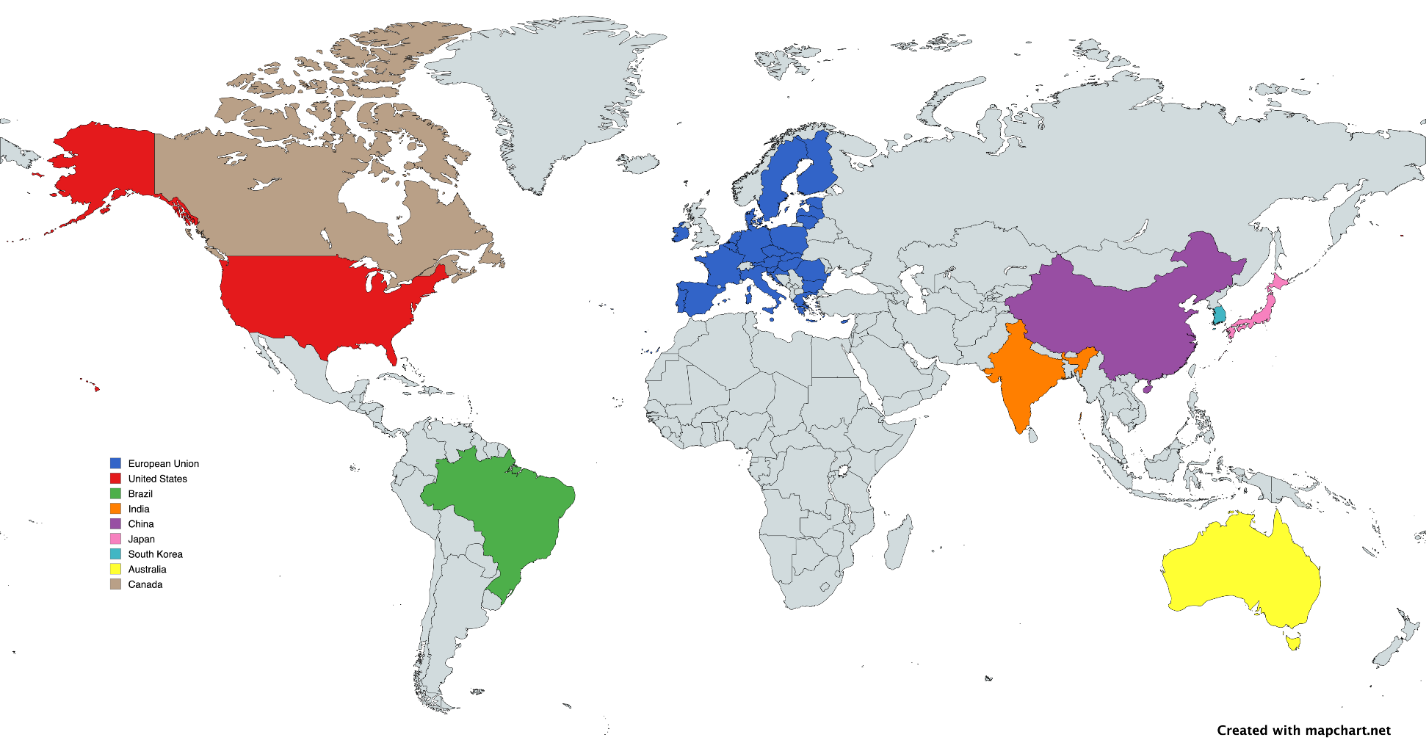








Medical device regulations around the world
Notes:
If you want to sell a medical device in a certain market, you have to submit it to their respective national authority.
USA: FDA – Food and Drug Administration
Canada: Health Canada
Brazil: ANVISA – Agência Nacional de Vigilância Sanitária
EU: While the European Commission provides overall guidance and coordination, the competent authorities in each member state play a crucial role in ensuring that the MDR is effectively implemented and enforced across the EU (in Portugal’s case, INFARMED)
China: CFDA – China Food and Drug Administration
India: CDSCO – Central Drugs Standard Control Organization
South Korea: MFDS – Ministry of Food and Drug Safety
Japan: PMDA – Pharmaceuticals and Medical Devices Agency

Slide 4


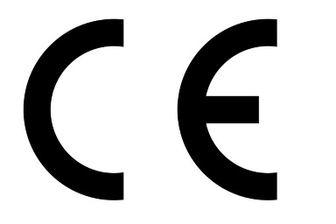
What is the EU MDR 2017/745?
Ensures high standards of safety and quality for medical devices that are:
produced in EU countries, or
supplied to EU countries
Regulation released in 2017 by the European Parliament and the Council of the EU
Has been in effect since 26 May 2021
Replaces the old Medical Device Directive (from 1993!)
Identifies what are medical devices
Standardises data and technological advances through EUDAMED
The certification of a medical device results in a CE mark
Notes:
Focusing on the European Medical Device Regulation for now, since it is the one that impacts us the most:
It was released in 2017 by the European Parliament and the Council of the European Union, in order to create a legal and regulatory framework that ensures high standards of safety and quality for what it considers medical devices that are produced or supplied to the countries belonging to the European Union
It has already entered into effect more than 3 years ago. Every new device certification now officially has to be done according to the MDR.
This is not the first European law concerning medical devices. The old Medical Device Directive has been around since 1993. It was no longer able to keep up with the innovations in the sector, for instance in SaMD or nanomaterials, for which there are now specific rules.
So, the MDR clears up what is considered a medical device and standardizes the way that their development is done and registered through the central european database – EUDAMED – which is the EU-level database of manufacturers and medical devices.
Medical devices that adhere to the MDR are given a CE mark which guarantees their safety and quality as devices meant to be used in a medical setting.

Slide 5
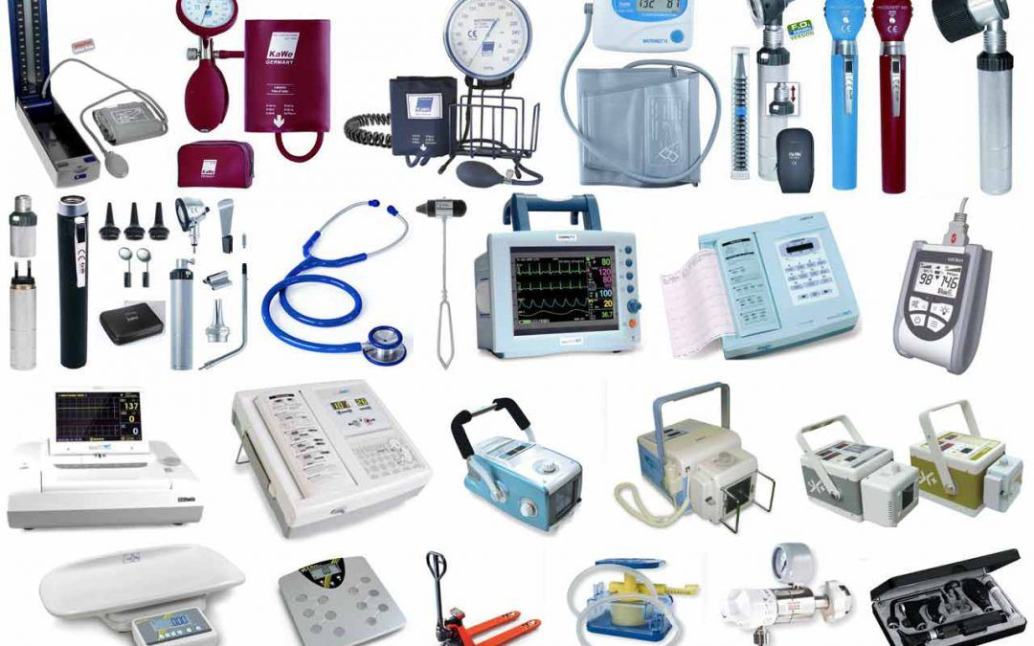
What is a medical device, according to the EU MDR?
Any:
Instrument
Equipment
Application
Software
Implant
Reagent
Material
…
For human use, with medical purposes
Notes:
It can be quite hard to establish what is and isn’t a medical device. Definitions vary, however, according to the new Medical Device Regulation, it could be any:
Instrument, equipment, application, software, implant, reagent, material or others, that are destined for human use, with one or more medical purposes in mind.

Slide 6
What is a medical device, according to the EU MDR?
Medical purposes
Diagnosis
Prevention
Monitoring
Prediction
Treatment
Relief
Compensation
Investigation
Substitution
Modification
Birth control and support
of a disease, lesion or disability
of a person’s anatomy, physiological or pathological process
Notes:
In this context, when we talk about medical purposes, we’re talking about dealing with a disease, lesion or disability. Here, the medical device may serve to diagnose, prevent, monitor, predict, treat, relieve or compensate any of these conditions.
A medical device may also serve to investigate, substitute or modify a person’s anatomy, physiological or pathological process.
Finally, devices used for birth control or support may also be considered medical devices.

Slide 7
How to classify a medical device
Class I |  |  |  | Class II |  | Class III
Non-invasive and non-implantable devices (w/ exceptions) |  |  |  | Active and invasive devices |  | Active and implantable devices intended for long-term use. Examples: pacemakers, breast implants, spinal disc implants, drug-coated stents.
Class I | Class Im | Class Ir | Class Is | Class IIa | Class IIb
Any other device that does not fit in any other subclass | Devices with a measuring function Example: thermometers. | Reusable devices and invasive surgical equipment of transient use Example: scalpels. | Sterile devices Example: colostomy bags. | Intended for short-term use. Examples: tooth implants, tracheotomy tubes, syringes, X-ray devices. | Intended for long-term use. Examples: implantable birth control, blood bags.
- RISK +
Notes:
Under the EU MDR, there are 22 rules for the classification of a medical device.
The rules are complex, and include a lot of exceptions, unless-kind of statements, that are difficult to convey in such a short presentation.
However, this table summarises a bit how medical devices can be classified, according to their intended use.
The level of risk rises with the class number. Class I devices are less risky than Class IIa, which are less risky than those in Class IIb. Class III devices are those that pose more risk.
Generally, devices that are non-invasive and non-implantable are Class I devices.
There are several sub-categories of Class I devices:
Class Im:
Class Ir:
Class Is:
Then there’s Class II devices, with are active and invasive, and can be divided into two classes: IIa and IIb.
The most risky of all are Class III devices.
Once again, the intended use that is declared by the manufacturer is very important for the classification of the device.
Invasive devices – devices that penetrate the body through an orifice or the surface of the body itself;
Implantable devices – devices that are completely introduced into the human body, or that replace an epithelial surface or the surface of the eye by clinical intervention;
Active devices – devices that depend on a source of energy other than that generated by the human body or by gravity;
Duration of use
Transient – < 60 minutes
Short-term – 60 minutes – 30 days
Long-term – > 30 days

Slide 8
Common standards used for Medical Device Development Applicable Standards
General standards (common to every medical device)
ISO 13485:2016: Quality Management System for medical devices industry
ISO 14971:2019: Risk Management for medical devices
Standards applicable to software
IEC 62304:2006: Software lifecycle for medical devices
Notes:
The EU MDR relies on standards that are harmonized with it to help manufacturers ensure that the device was designed and manufactured in a good and safe way.
Source: https://blog.cm-dm.com/post/2011/11/01/ISO-and-IEC-standards-explained-to-software-engineers-and-quality-managers

Slide 9
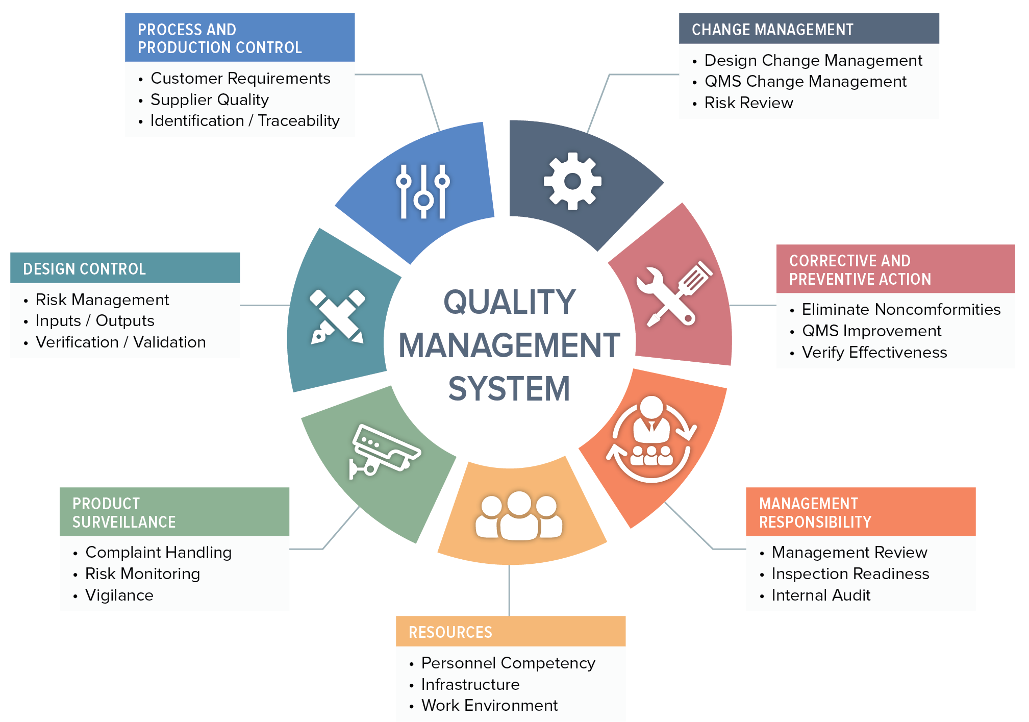
Quality Management System ISO 13485:2016
According to the MDR, the QMS:
shall cover all parts and elements of a manufacturer's organisation dealing with the quality of processes, procedures and devices
shall govern the structure, responsibilities, procedures, processes and management resources required to implement the principles and actions necessary to achieve compliance
Cited from: REGULATION (EU) 2017/ 745, Article 10(8)
Source: https://www.orielstat.com/blog/medical-device-qms-overview/
Notes:
It is a system, or a set of instructions, that defines how a company should execute business activities. It deals with quality processes, procedures and devices and oversees the company's structure, responsibilities, procedures, processes and management resources. This system is continuously being monitored and updated and improved to achieve the quality standards requested by the regulatory framework.
The MDR does not require that a specific Quality Management System has to be in place. However, the one described in ISO 13485 is in practise the only one that’s described in the form of a standard, so it has a guarantee that it is well reviewed and accepted, not only in the European Union, but also in much of the rest of the world: the United States, Canada, Japan, Australia, Singapore and Malaysia are some examples.

Slide 10
Risk Management
ISO 14971:2019: Key principles
Ongoing process, through all the stages in the process lifecycle
Systematic Approach
Decisions based on harm to the patients
Regularly reviewed and updated
Risk-Based Thinking
Continuous Improvement
Notes:
The key principles of Risk Management:
Systematic Approach: Risk management should be an ongoing process, integrated into all stages of the device lifecycle.
Risk-Based Thinking: Decisions should be based on the level of risk associated with potential hazards.
Continuous Improvement: The risk management process should be regularly reviewed and updated to address new information or changes in the device or its environment.

Slide 11
Risk Management
ISO 14971:2019 – Steps involved
Hazard Identification
Risk Monitoring and Review
Risk Analysis
Risk Control
Risk Evaluation
Notes:
Hazard Identification:
Identify all potential hazards that could cause harm to patients, users, or others.
Consider both known and foreseeable hazards.
Use various methods, such as brainstorming, failure mode and effects analysis (FMEA), and hazard analysis and critical control point (HACCP).
Risk Analysis:
Evaluate the likelihood and severity of each identified hazard.
Use risk matrices or other quantitative or qualitative methods.
Consider factors such as the frequency of exposure, the severity of potential harm, and the existence of mitigation measures.
Risk Evaluation:
Determine whether the identified risks are acceptable based on the intended use of the device and the benefits to patients.
Consider regulatory requirements, ethical considerations, and societal values.
Risk Control:
Implement measures to reduce or eliminate identified risks.
Consider a hierarchy of controls: elimination, substitution, engineering controls, administrative controls, and personal protective equipment (PPE).

Slide 12
Risk Management
ISO 14971:2019 – Risk calculation matrix
Acceptability Boundary
SEVERITY
 | Negligible | Minor | Moderate | Major | Severe
Very Unlikely | LOW | LOW | LOW | MEDIUM | HIGH
Unlikely | LOW | LOW | MEDIUM | MEDIUM | HIGH
Possible | LOW | MEDIUM | MEDIUM | MEDIUM | HIGH
Likely | LOW | MEDIUM | MEDIUM | HIGH | HIGH
Very Likely | LOW | MEDIUM | HIGH | HIGH | HIGH
LIKELIHOOD
Risk Control

Slide 13
Risk Management
ISO 14971:2019 – What does a “risk” look like?
Hazard: Clinician enters a medication dosage for the patient that is too high
Cause: Clinician is distracted or enters a typo
Harm: The patient takes a medication with a dosage that is too high and causes a seizure
Likelihood: Unlikely
Severity: Moderate
Resulting risk level: MEDIUM
Mitigation measure: Implement a functionality that validates entered dosages relative to reference levels and the patient’s information
Residual likelihood: Very Unlikely
Residual severity: Moderate
Residual risk level: LOW
This risk level is acceptable.
A risk mitigation measure is needed

Slide 14
Risk Management
ISO 14971:2019 – What does a “risk” look like?
SEVERITY
 | Negligible | Minor | Moderate | Major | Severe
Very Unlikely | LOW | LOW | LOW | MEDIUM | HIGH
Unlikely | LOW | LOW | MEDIUM | MEDIUM | HIGH
Possible | LOW | MEDIUM | MEDIUM | MEDIUM | HIGH
Likely | LOW | MEDIUM | MEDIUM | HIGH | HIGH
Very Likely | LOW | MEDIUM | HIGH | HIGH | HIGH
Before mitigation measure (initial risk)
After mitigation measure (residual risk)
LIKELIHOOD

Slide 15

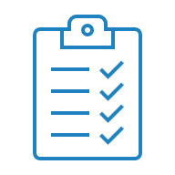

Software Lifecycle
IEC 62304:2006
Base documents
Software Requirements Specification (SRS)
Device’s intended use and users
List of functional, non-functional, regulatory and other requirements
Software Design Specification (SDS)
Description of components
Architecture (UML diagrams, …)
Resource usage
Off the shelf/third party software usage
SRS
SDS

Slide 16
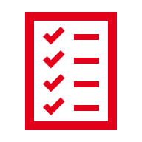


Software Lifecycle
IEC 62304:2006
Evidence documents
VRR
VLR
RTM
<
>
Verification Report
Static analysis/Linter report
Unit test results
Validation Report
Functional test results (either manual or automated)
Req. Traceability Matrix
Connects tests with the SRS
Ensures requirements are covered and tested

Slide 17
What about cybersecurity concerns?
STRIDE model
S T R I D E
Spoofing
Tampering
Repudiation
Information Disclosure
Denial of Service
Elevation of Privileges
Pretending to be someone else
Modification of data: in storage, within a network or in memory
Hiding operations or the responsibilities for them
Gaining access to sensitive information
Consumption of system resources to the extent that legitimate users cannot use the system
Performing an operation without proper authorization
Authenticity
Integrity
Non-Repudiation
Confidentiality
Availability
Authorization
Notes:
The STRIDE threat model, developed by Microsoft in 1999, categorizes potential threats into six major groups.
S: Spoofing is the act of pretending to be someone else. For example, an attacker might steal a user’s password to log in to their account. To avoid this, measures must be implemented to ensure that the person logging in is the expected user, thereby guaranteeing authenticity in the system.
T: Tampering involves the malicious modification of data, whether on a hard disk, within a network, or in memory. This occurs, for example, when an attacker intercepts and alters data traveling over the network. To prevent such actions and ensure system integrity, these modifications must be detectable.
R: Repudiation involves causing the system to believe that an operation was not performed or that a user is not responsible for it. For example, repudiation can occur when an attacker successfully modifies the system’s audit logs to obscure their activities. To prevent such scenarios, measures must be implemented to ensure non-repudiation in the system.
I: Information disclosure occurs when an unauthorized user gains access to sensitive information. This can happen if a system is poorly configured, exposing sensitive details to the public, or when an attacker intercepts data traveling over the network and steals it. To ensure system confidentiality, the use of encryption mechanisms is recommended.
D: A Denial of Service (DoS) attack involves the consumption of system resources to the extent that legitimate users cannot access the service. This occurs when an attacker floods the system with excessive requests, rendering it inaccessible. In such cases, alternative access methods must be established to ensure system availability.
E: An elevation of privileges occurs when someone performs an operation without proper authorization. This can happen if an attacker manages to steal login credentials and uses them to access a system with elevated privileges. To prevent this, measures must be implemented to ensure proper system authorizations are maintained.

Slide 18
What about cybersecurity concerns?
Cybersecurity concerns can be dealt with within the risk management process
Digital data
Physical documents
IP
Knowledge, skills of employees
Servers and infrastructure
1
Identify Assets
Communication interfaces (Bluetooth, Wi-fi, ...)
Human factors
4
2
Manage Risk
Identify Attack Surfaces
3
Apply the STRIDE Model
Identify Hazards
Notes:
1 - Identifying Information Assets
An information asset is a resource within an organization’s infrastructure that must be protected due to its value. These assets include digital data, physical documents, intellectual property, and the knowledge and skills of employees.
Their value exposes them to various threats and risks, such as unauthorized access, data breaches, malware attacks, system failures, and other cyber threats.
2 - Identifying Attack Surfaces
An attack surface is all the potential entry points through which an attacker can exploit vulnerabilities to gain unauthorized access to a system and cause damage.
It encompasses the connections between system components where information is transmitted, or operations are performed. An example of this could be the Bluetooth connection between a phone and another device.
When developing a software, it is advisable to minimize the number of potential attack surfaces to enhance security.
3 – Applying the STRIDE Threat Model to Each of the Assets and Surfaces Identified
To effectively apply the STRIDE threat model to each identified asset and surface, we recommend creating a cybersecurity analysis matrix.
This matrix evaluates the potential cybersecurity risks across each communication channel for all data in transit throughout the system.
4 – Performing Risk Management
Assess consequences, initial risk levels, mitigation measures and residual risks.

Slide 19
Software Lifecycle
IEC 62304:2006 – How to integrate it into an Agile development methodology
FEATURE IMPLEMENTATION, TESTING
SPRINT
SPRINT PLANNING MEETING
SPRINT RETROSPECTIVE MEETING
SRS, SDS
VRR, VLR, RTM
Notes:
A sprint in Agile methodologies is a time-boxed period during which a team works to complete a specific set of tasks. Sprints are iterative.
When starting a sprint, the team should take into account the design inputs, and hold a sprint planning meeting.
During the sprint, changes to the product are done according to the decisions made during the sprint planning meeting.
At the end of the sprint, a sprint retrospective meeting is held, and the design outputs are documented.
Design inputs:
Requirements Specification: system requirements, user requirements, regulatory requirements (b) (c)
System Architecture Specification: depiction of how the different blocks of the system are integrated (e.g. using UML diagrams), API references (b) (c)
Approved design changes (c)
During the sprint planning meeting:
Feature plan: features to work on during the sprint, selected and linked from the Requirements, with an indication of responsibilities for implementation (done using Jira) (b)
This includes features targeted for a specific release, which may or may not occur at the end of the sprint
Test Plan: a plan of the tests to write and execute by the QA team, selected and linked from the features. (b)
Design outputs:
Test report: evidence that code changes made by a developer were reviewed and approved by another developer, evidence that some sort of static analysis was performed, evidence of the tests executed (unit tests written and executed by the developers, functional/UI tests written and executed by the QA team) and their results (d) (f) (g)
Traceability matrix from requirements to test results (d)
Requirements with failing or pending tests are not considered implemented and that feature may not yet be delivered in a release
Requirements without failing or pending tests mark features that may be delivered in a release
During sprint retrospective meeting:
Design review (e) – if a new MAJOR or MINOR release increment is observed (refer to answer to question 2.4)
Design history file (DHF) update (j)

Slide 20
General Data Protection Regulation (GDPR)
Overview
Purpose: Protects the personal data and privacy of EU citizens, applying to any organization that processes their data, globally.
Key Principles: Lawfulness, Fairness & Transparency; Data Minimization; Purpose Limitation; Accuracy; Security; Storage Limitation.
Data Subject Rights: Access, Rectification, Erasure (Right to be Forgotten), Portability, Object, Restrict.
Breach Reporting: Notify authorities within 72 hours of a data breach.
Accountability: Keep detailed records and ensure compliance via Data Protection Impact Assessments (DPIAs) and Data Processing Agreements (DPAs) with third parties.
Notes:
The GDPR is a EU law that focuses on protecting the personal data and privacy of EU citizens. It applies not just to companies in the EU but to any organization globally that processes the personal data of EU citizens.
Key principles:
Lawfulness, Fairness, and Transparency: Data must be collected and used in a lawful, fair, and transparent manner.
Data Minimization: You should only collect the data that is strictly necessary for your purpose—no more, no less.
Purpose Limitation: Data should only be used for the specific purpose it was collected for.
Accuracy: Organizations must ensure that personal data is kept accurate and up to date.
Security: Robust measures, like encryption and access controls, must be in place to protect personal data from unauthorized access or breaches.
Storage Limitation: Data should only be retained for as long as it’s needed, and no longer.
Data subject rights are a major focus of GDPR. Individuals have the right to:
Access their data,
Correct inaccurate data,
Request their data to be erased, also known as the Right to be Forgotten,
Transfer their data to another provider, and
Object or restrict certain uses of their data, such as for marketing.
If a data breach occurs, organizations must report it to the relevant authorities within 72 hours, and potentially inform the affected individuals as well.
Finally, accountability is crucial under GDPR. Organizations are expected to maintain detailed records of their data processing activities, conduct Data Protection Impact Assessments (DPIAs) for high-risk activities, and ensure compliance by having Data Processing Agreements (DPAs) in place with third-party processors.
In addition to the new AI Act, we also need to make sure our use of personal data complies with the GDPR. This is especially important for AI systems, which rely heavily on data. When it comes to health data, the rules are even more stringent. We need to make sure we have a valid lawful basis for processing personal data, that we follow key data protection principles like minimization and security, that we uphold data subject rights, and that we maintain clear records and documentation. Especially for high-risk processing like in AI systems, we need to do data protection impact assessments to identify and mitigate risks.

Slide 21
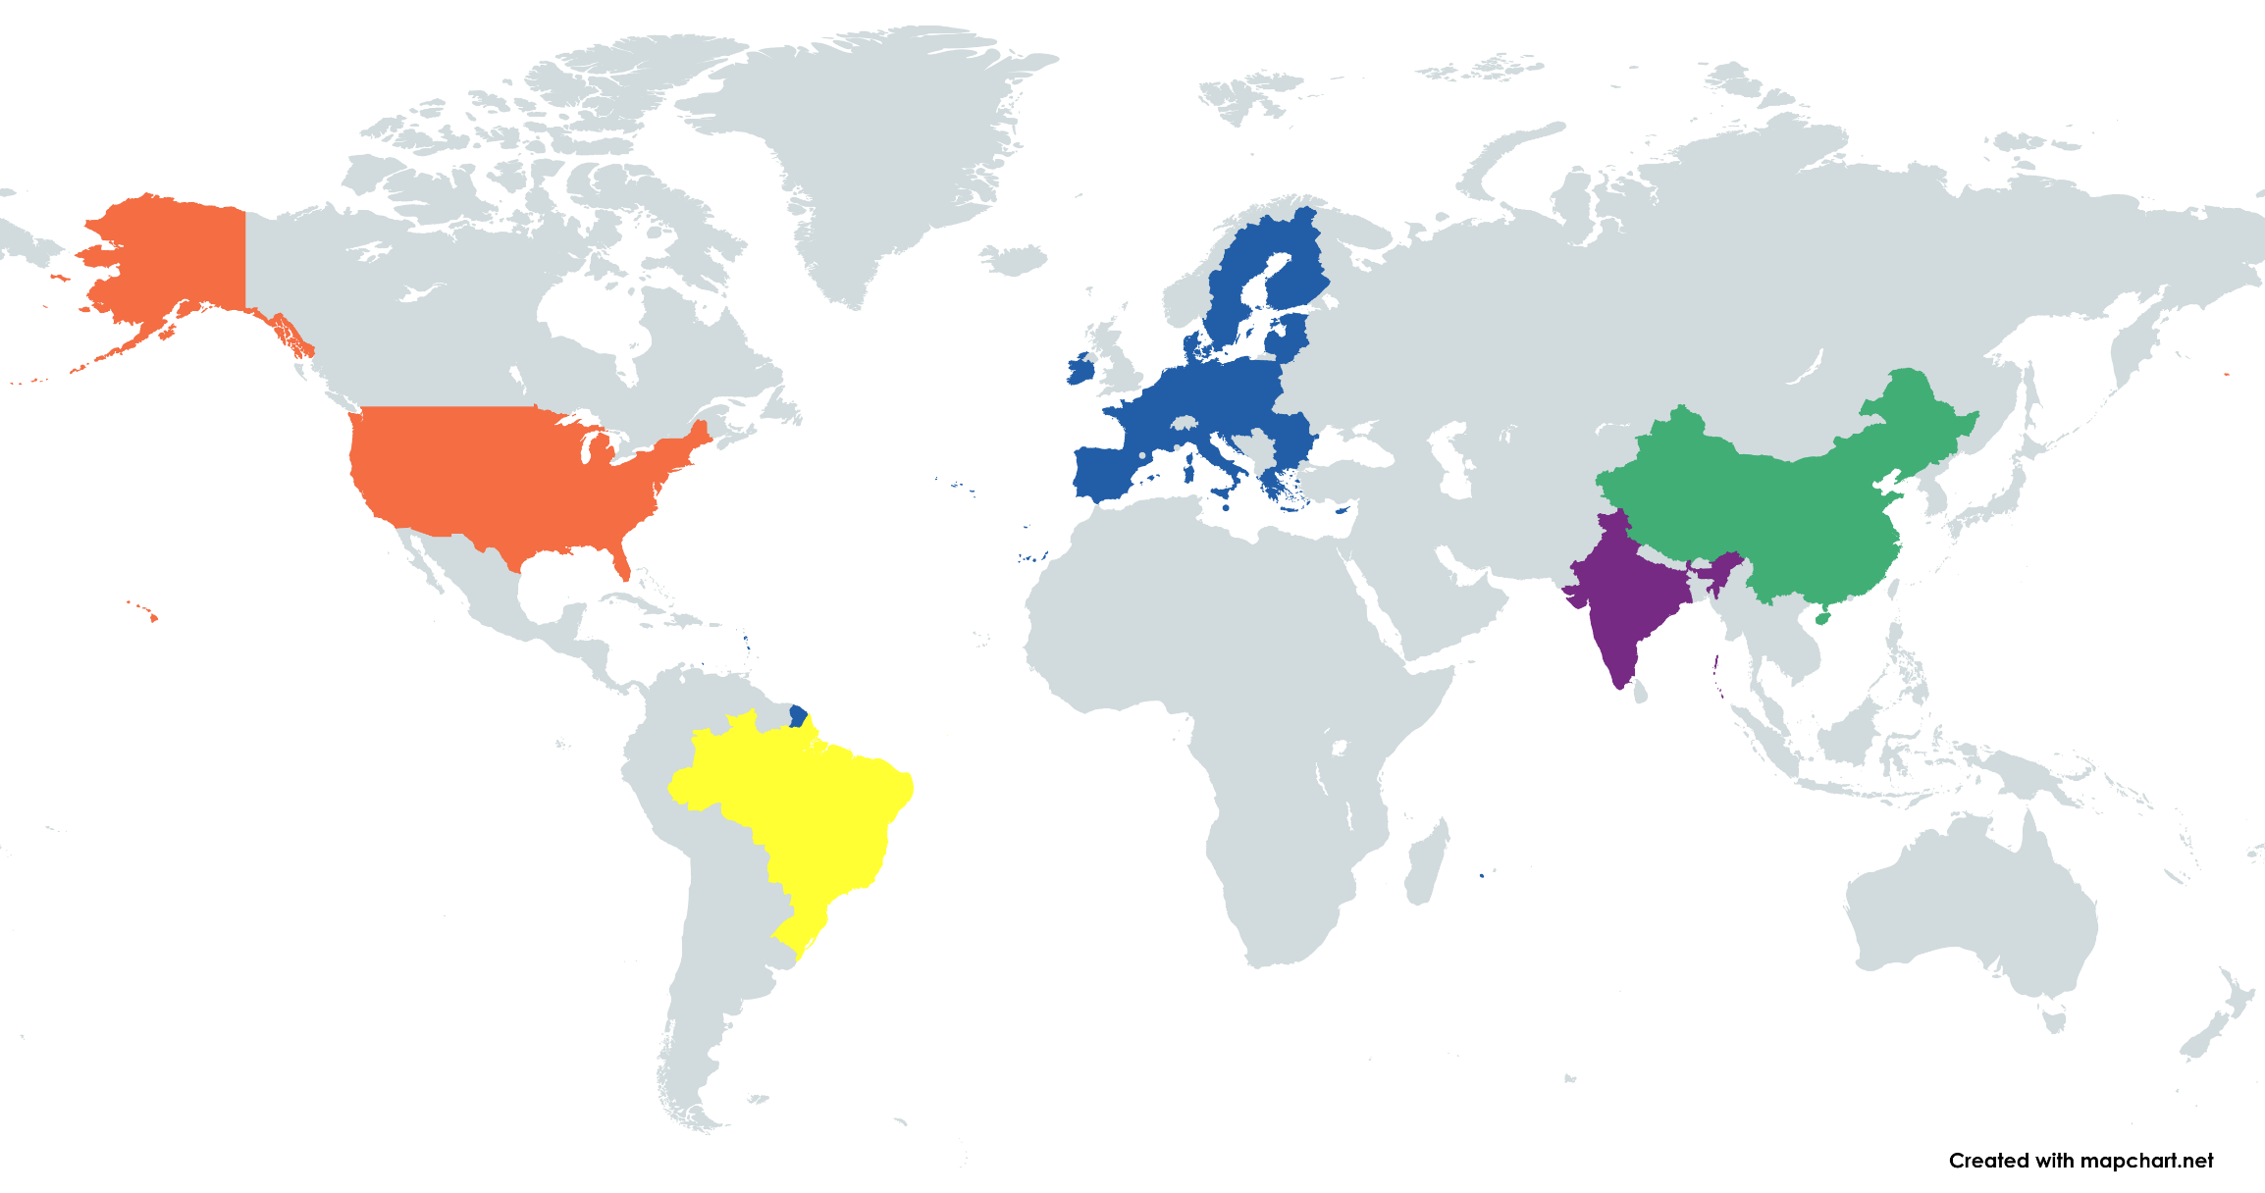





Global Regulatory Landscape for AI
AI Liability Directive
Platform Work Directive
EU AI Act
Algorithmic Accountability Act
New York City's Local Law 144
…
Regulations on algorithmic systems
Civil Rights Framework for the Internet
AI Bill
Digital India Act
Notes:
There's a global recognition of the need for legislation to ensure the responsible deployment of AI
Europe:
The AI Liability Directive simplifies liability for AI-related damages, making it easier for individuals to seek compensation.
The Platform Work Directive enhances rights for platform workers, addressing employment status and algorithmic management.
The EU AI Act adopts a risk-based approach to regulate AI, emphasizing transparency and human oversight.
North America:
In the USA, various federal and state laws—such as the Algorithmic Accountability Act and New York City's Local Law 144—focus on transparency, accountability, and non-discrimination in AI employment tools.
South America:
Brazil has enacted the Civil Rights Framework for the Internet and is debating a proposed AI Bill, both emphasizing data privacy and setting responsibilities for companies in AI development and deployment.
Asia:
China has implemented regulations on algorithmic systems to ensure data privacy and responsible AI use.
India is proposing the Digital India Act, which introduces rights against automated decision-making and mandates algorithmic accountability.

Slide 22
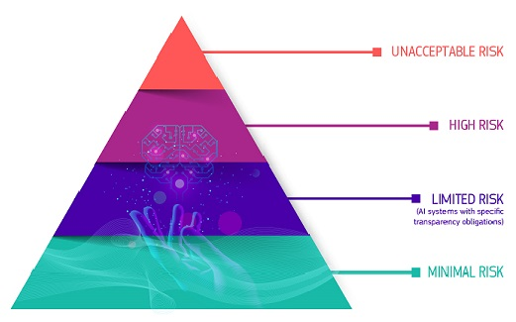
EU AI Act
Overview
It establishes a risk-based framework, classifying AI systems into four categories based on their potential risks to safety and fundamental rights:
Unacceptable risk: Banned (ex: AI for social scoring or manipulation).
High risk: Heavily regulated (ex: AI in healthcare, law enforcement, employment).
Limited risk: Subject to transparency requirements (ex: AI chatbots).
Minimal risk: No specific regulations (ex: spam filters).
The AI Act is a regulation proposed by the European Union to govern the development, deployment, and use of AI systems.
Notes:
The AI Act prohibits certain unacceptable uses of AI entirely, like exploiting mental vulnerabilities to distort behavior in a harmful way. It also defines high-risk AI systems that must meet strict requirements. This includes AI used in regulated products like medical devices, as well as stand-alone diagnostic and health systems. High-risk systems must provide extensive documentation on their development, undergo testing to demonstrate they meet quality criteria, be registered in a public database, and more. Let's look at those requirements

Slide 23
EU AI Act
Timeline
2 Aug. 2024
Entry into force
2 Feb. 2025
Ban on AI systems with unacceptable risk
2 May 2025
Codes of conduct are applied
2 Aug. 2025
Governance rules and obligations for General Purpose AI (GPAI) become applicable
2 Aug. 2026
Start of application of the EU AI Act for high-risk AI systems
2 Aug. 2027
Application of the entire EU AI Act for all risk categories

Slide 24
AI Act
Requirements for High-Risk Systems
AI systems in healthcare (ex. diagnostic tools, medical imaging analysis) are classified as high-risk due to their direct impact on patient safety.
Key Requirements for High-Risk AI Systems:
Data Quality: Must ensure that training data is accurate, reliable, and unbiased.
Transparency: Systems must be explainable to users (ex, doctors, patients) with clear documentation of AI decision-making processes.
Human Oversight: AI must work alongside human professionals, providing assistive functions rather than fully autonomous decision-making.
Conformity Assessments: AI systems must undergo assessments before being deployed to ensure they meet safety and performance standards.
Notes:
When developing AI for medical applications, it’s an engineer responsibility to ensure the data is validated, bias is minimized, and the AI model’s decision-making process is well-documented.
This means developers will be responsible not only for creating functional systems but also ensuring those systems comply with regulatory standards like the AI Act to protect patient safety and privacy.
In summary, the AI Act will shape how you design and develop AI solutions, particularly in high-stakes industries like healthcare. Understanding these regulations is essential for creating ethical and compliant software solutions.

Slide 25
Artificial Intelligence Standards
Key Organizations Producing AI Standards
ISO/IEC JTC 1/SC 42 (Global): Global AI standards on trust, bias, and transparency.
ITU (Global): Ethics and safety in global AI applications.
ETSI (EU): AI in telecom (5G, cybersecurity) in Europe.
NIST (USA): AI risk management, fairness, and reliability.
CEN/CENELEC (EU): AI in medical devices, robotics.
25 standard producers
311 published standards
43 in draft/pre-draft stage
Useful resource: https://aistandardshub.org/
Notes:
25 organizations producing standards
Around 311 already published
Around 43 in draft/pre-draft stage

Slide 26
Artificial Intelligence Standards
Most relevant AI Standards
ISO/IEC 5338:2023 - AI System Lifecycle Processes
Covers processes across the full lifecycle: design, development, testing, deployment, operation and maintenance
Addresses the potential for:
performance degradation over time;
the autonomous nature of the systems;
the heavy reliance on data;
the need for continuous monitoring;
The need to retrain and update the system over time as its environment evolves.
Notes:
ISO/IEC 5338
Adapts existing lifecycle standards to the unique aspects of AI, such as the potential for performance degradation over time, the autonomous nature of the systems, the heavy reliance on data, and the need for continuous monitoring.
It covers processes across the full life cycle, including design, development, testing, deployment, operation and maintenance. A key point is the potential need to retrain and update the system over time as its environment evolves.

Slide 27
Artificial Intelligence Standards
Most relevant AI Standards
ISO/IEC 23894:2023 - Guidance on Risk Management for AI
Guidance on managing the unique risks that can arise with AI systems
It highlights AI-specific risk sources and failure modes that we need to consider:
lack of explainability;
unreliable performance in complex environments;
inherent biases and privacy issues from training data.
To manage risks, include impact assessments, human oversight, continuous monitoring, and ensure high data quality
Notes:
ISO/IEC 23894:
Guidance on managing the unique risks that can arise with AI systems
It highlights AI-specific risk sources and failure modes that we need to consider, like lack of explainability, unreliable performance in complex environments, inherent biases and privacy issues from training data, and so on.
It shows how these risks can negatively impact key objectives and principles for AI systems around fairness, transparency, privacy, robustness and more.
To manage the risks, it emphasizes the importance of impact assessments, human oversight, continuous monitoring, and ensuring really high data quality.

Slide 28
Artificial Intelligence Standards
Most relevant AI Standards
ISO/IEC 42001:2022 - AI Management System
Goal: Responsible use and development of AI systems
Outlines requirements for:
Policies and principles on the use of AI;
Processes to identify and manage AI risks;
Assignment of roles and responsibilities;
Maintaining documentation;
Monitoring performance.
Notes:
ISO/IEC 42001:
It outlines requirements for clear policies and principles on the use of AI, thorough processes to identify and manage AI risks, assignment of roles and responsibilities, maintaining documentation, and monitoring performance.
It includes a catalog of key topics to address, like data management, transparency, impact assessments, and so on.
The goal is to systematically ensure AI systems are developed and used responsibly.

Slide 29
Compliance with standards and regulations
Actions for developers
STEP 1: Integrate Compliance into the AI Development Workflow
Action: Integrate compliance checks early in the development lifecycle by building a compliance-by-design approach.
How:
Identify and document potential risks such as bias, transparency issues, and model security vulnerabilities early in the process.
Implement data drift and concept drift detection to track changes in model behavior over time (ex. WhyLabs).
Ensure fairness in data and models, by using tools like Fairness Indicators or IBM AI Fairness 360.
Maintain a versioned record of datasets (ex. DVC) and models (ex. MLflow) to ensure traceability for audits.
Conformity Assessment: Prepare documentation including risk assessments reports, model test results and compliance reports, aligning with the AI Act and MDR.
Related Standards/Regulations: ISO/IEC 23894:2023, ISO/IEC 42001:2023, AI Act, MDR

Slide 30
Compliance with standards and regulations
Actions for developers
STEP 2 : Implement Data Privacy Mechanisms in Your Code
Action: Incorporate data minimization, encryption, and pseudonymization practices within your system’s architecture.
How:
Implement data minimization to limit exposure to sensitive data through techniques like differential privacy.
Apply encryption for data at rest and in transit.
Develop APIs that manage user consent and deletion requests, ensuring compliance with GDPR's right to be forgotten and AI Act transparency requirements.
Data Breach Reporting: Set up alerts to ensure quick detection and reporting of any data breaches within 72 hours.
Related Standards/Regulations: GDPR, ISO/IEC 42001:2023, AI Act

Slide 31
Compliance with standards and regulations
Actions for developers
STEP 3 : Model Explainability and Accountability
Action: Ensure that AI models are explainable and accountable, especially for high-risk applications.
How:
Implement methods to explain model decisions, making results understandable for users and regulators.
Use LIME or SHAP for generating explanations of complex model predictions
Develop user interfaces using Streamlit that allow users to query model decisions
Log each model prediction and the data inputs that influenced it to maintain transparency (ex. MLflow).
Human Oversight: Provide an interface for human operators to review and override AI decisions as needed.
Related Standards/Regulations: ISO/IEC 5338:2023, AI Act, MDR

Slide 32
Compliance with standards and regulations
Actions for developers
STEP 4 : Model Validation and Testing
Action: Integrate thorough model validation into your development process.
How:
Regularly test models for accuracy, fairness, and safety through unit tests, integration tests and functional tests (ex. Deepckecks).
Clinical Evaluation (MDR): For medical AI systems, ensure models are validated against real-world clinical data and document all evaluation results.
Related Standards/Regulations: ISO/IEC 5338:2023, AI Act, MDR

Slide 33
Compliance with standards and regulations
Actions for developers
STEP 5 : Ensure Post-Deployment Monitoring and Maintenance
Action: Continuously monitor deployed models to ensure they perform safely and reliably.
How:
Track model performance, detecting and responding to anomalies.
Set up incident logging and alerts for performance degradations or bias issues, ensuring that relevant stakeholders are notified for quick remediation (ex. Evidently AI).
Automate updates and model retraining (ex. Seldon Core) when performance metrics fall below acceptable levels, ensuring ongoing compliance with MDR surveillance requirements.
Log all updates and performance changes to maintain a record for AI Act audits and conformity assessments.
Related Standards/Regulations: ISO/IEC 42001:2023, MDR, AI Act

Slide 34
Compliance with standards and regulations
Actions for developers
STEP 6 : Document Everything and Build for Auditability
Action: Create detailed documentation of your AI system's development and lifecycle.
How:
Maintain clear documentation of all data handling, model training, and testing processes.
Use model cards to outline the purpose, performance, and ethical considerations for each model.
Related Standards/Regulations: ISO/IEC 42001:2023, MDR, AI Act

Slide 35
Compliance with standards and regulations
Actions for developers
STEP 7 : Integrate security measures and ethical practices into your AI systems
Action: Develop and integrate security measures to protect against vulnerabilities and ensure ethical use of AI.
How:
Secure data exchanges and model endpoints using industry-standard encryption protocols.
Evaluate models for fairness and ensure that models respect the diversity of user groups.
Implement ethical AI principles by designing systems that allow user feedback on model performance, especially in clinical environments under MDR.
Document all security measures and ethical considerations to ensure compliance with AI Act requirements for ethical AI use.
Related Standards/Regulations: GDPR, AI Act, MDR

Slide 36
Compliance with standards and regulations
Actions for developers
STEP 8 : Conduct Internal Audits and Prepare for Conformity Assessments
Action: Regularly audit AI systems to ensure compliance and readiness for regulatory reviews.
How:
Document the results of audits to ensure easy access during regulatory reviews.
Compile a package of clinical evaluations, risk management reports, and post-market surveillance data, as required by both the MDR and AI Act, for external audits and CE marking.
Engage with a notified body for external reviews of high-risk AI systems, ensuring readiness for CE marking under MDR
Related Standards/Regulations: ISO/IEC 42001:2023, MDR, AI Act

Slide 37
Compliance with standards and regulations
Actions for developers
STEP 9 : Include UDI Implementation and Traceability
Action: Implement Unique Device Identification (UDI) for AI-based medical devices.
How:
Maintain a secure database of UDI codes, ensuring each version of the AI model has a traceable identifier.
Register UDI codes with EUDAMED and keep a detailed log of all model versions, including updates and changes for regulatory tracking.
Use DVC to track changes to models associated with each UDI to ensure traceability throughout the lifecycle of the device
Related Standards/Regulations: MDR

Slide 38
Compliance with standards and regulations
Actions for developers
STEP 10 : Incorporate Data Subject Rights Management
Action: Respect data subject rights, including access, rectification, and erasure.
How:
Develop APIs to handle data access and deletion requests, ensuring user data is managed according to GDPR standards..
Log each request and maintain records of actions taken to comply with data privacy regulations.
Set up procedures to respond quickly to data breaches, ensuring compliance with GDPR’s 72-hour reporting requirement.
Document all interactions with data subjects and maintain these records for audits under GDPR and the AI Act
Related Standards/Regulations: GDPR, AI Act

Slide 39
Conclusion
Key takeways for developers
Conformity Assessment Readiness:
Prepare comprehensive documentation for audits under the AI Act and MDR, ensuring readiness for reviews.
Human Oversight Mechanisms:
Provide clear paths for human intervention where required, ensuring that human operators can override AI decisions.
Data Security and Privacy:
Focus on minimizing data exposure and ensuring compliance with GDPR through built-in privacy measures.
Clinical Evaluation:
Validate AI systems in real-world environments when used in medical applications, maintaining safety and performance records.

